Slide 1
Personifying Resilience Through Narrative:
Performing Pedigree
Presenter
Brittney S. Harris, Asst. Professor of Theatre
Old Dominion University
b1harris@odu.edu

Slide 2
About My Research
Areas of Expertise
Race and Performance, Performance as Activism, and Devised Community-Engaged Theatre.
  Can be categorized as “Applied Theatre”
Ideological/ Methodological Approach
  - Theatre of the Oppressed, Augusto Boal
  - Theatre for Community, Conflict, and Dialogue, Michael Rohd

Slide 3
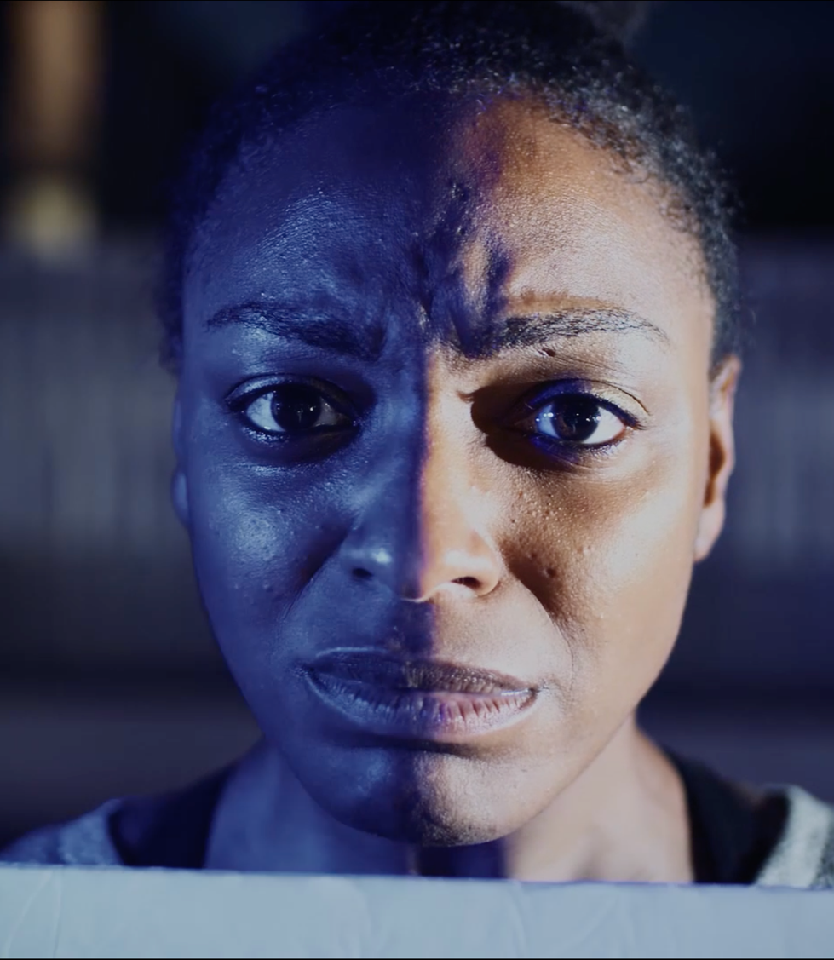
Embodying A Resolution…
At the foundation of our own existence is the desire to identify and understand one's own purpose. Artistic expression, for years, has been an outlet for exploring such depths. In the means of theatrical performance, there is a platform that exists for artists to explore their own roots, questions about morals and society, and spirituality.
Topics addressed:
About Performance as Activism
  HOW & WHY THIS WORK?
Setting the Stage: Performance as Activism Methodologies and Techniques
Case Study: Pedigree

Slide 4
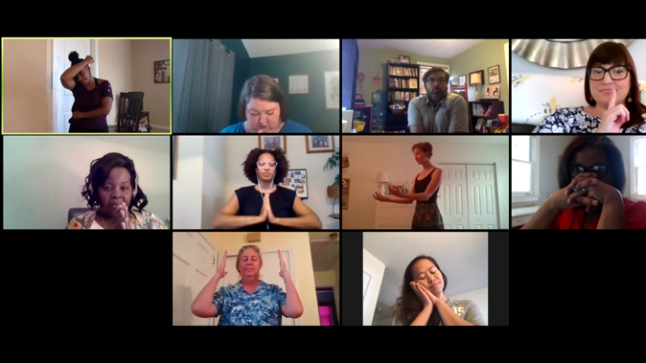
“Not just for entertainment purpose but enlightening purposes”
From ‘Resilient Stillness ‘Workshop: 2020 ODU Summer Arts Series

Slide 5
Performance as Activism:
WHAT?
Performative activism relies on an ability to tell stories to diverse audiences that will inspire action toward justice
Live theatrical performances in particular offer an exceptional form of audience engagement that human rights organizations may find more meaningful than the circulation of literature and rhetoric
Theatre is also a highly adaptable medium, able to be molded over and over according to the vision of its social and cultural location

Slide 6
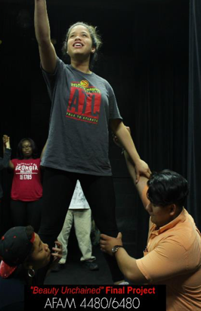
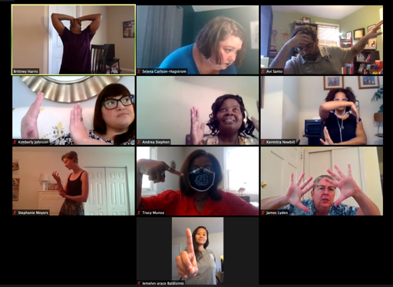
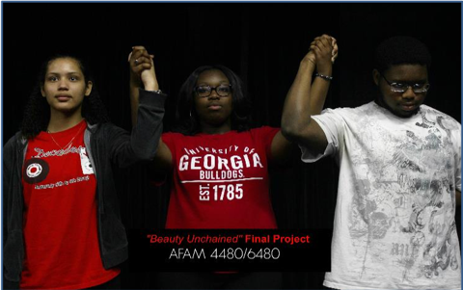
A Tool of
Illumination
&
Challenges
systems of power
redefining of “social roles/norms,
&
extended platform to amplify causes or culturally/socially relevant issues that are often oppressed, undermined, or underserved.
Encourages interactive social collaborative process

Slide 7
Performance as Activism:
WHY?
Using performance as activism provides a set of collaborative tools adapted to/for artists and spectators that utilizes a unique skill set of:
Creative Expression and Exploration,
Community Building (advocates from various industry professionals as it pertains to the issue/topic at hand)
Conflict resolution, Dialogue, and Discourse

Slide 8
Performance as Activism:
Select Methodologies/Techniques
Image Theatre
Theatre of the Oppressed
Augusto Boal
Still images are used to explore abstract concepts, such as relationships and emotions, as well as realistic situations.
These images are then placed together and ‘dynamized’ or brought to life. The method is often used to explore internal or external oppression, unconscious thoughts and feelings.
Cop-In-Head
Theatre of the Oppressed
Augusto Boal
A powerful technique that explores internalized oppression — the internal voices, societal messages, obstacles, fears, etc., that prevent one from living fully and liberated.

Slide 9
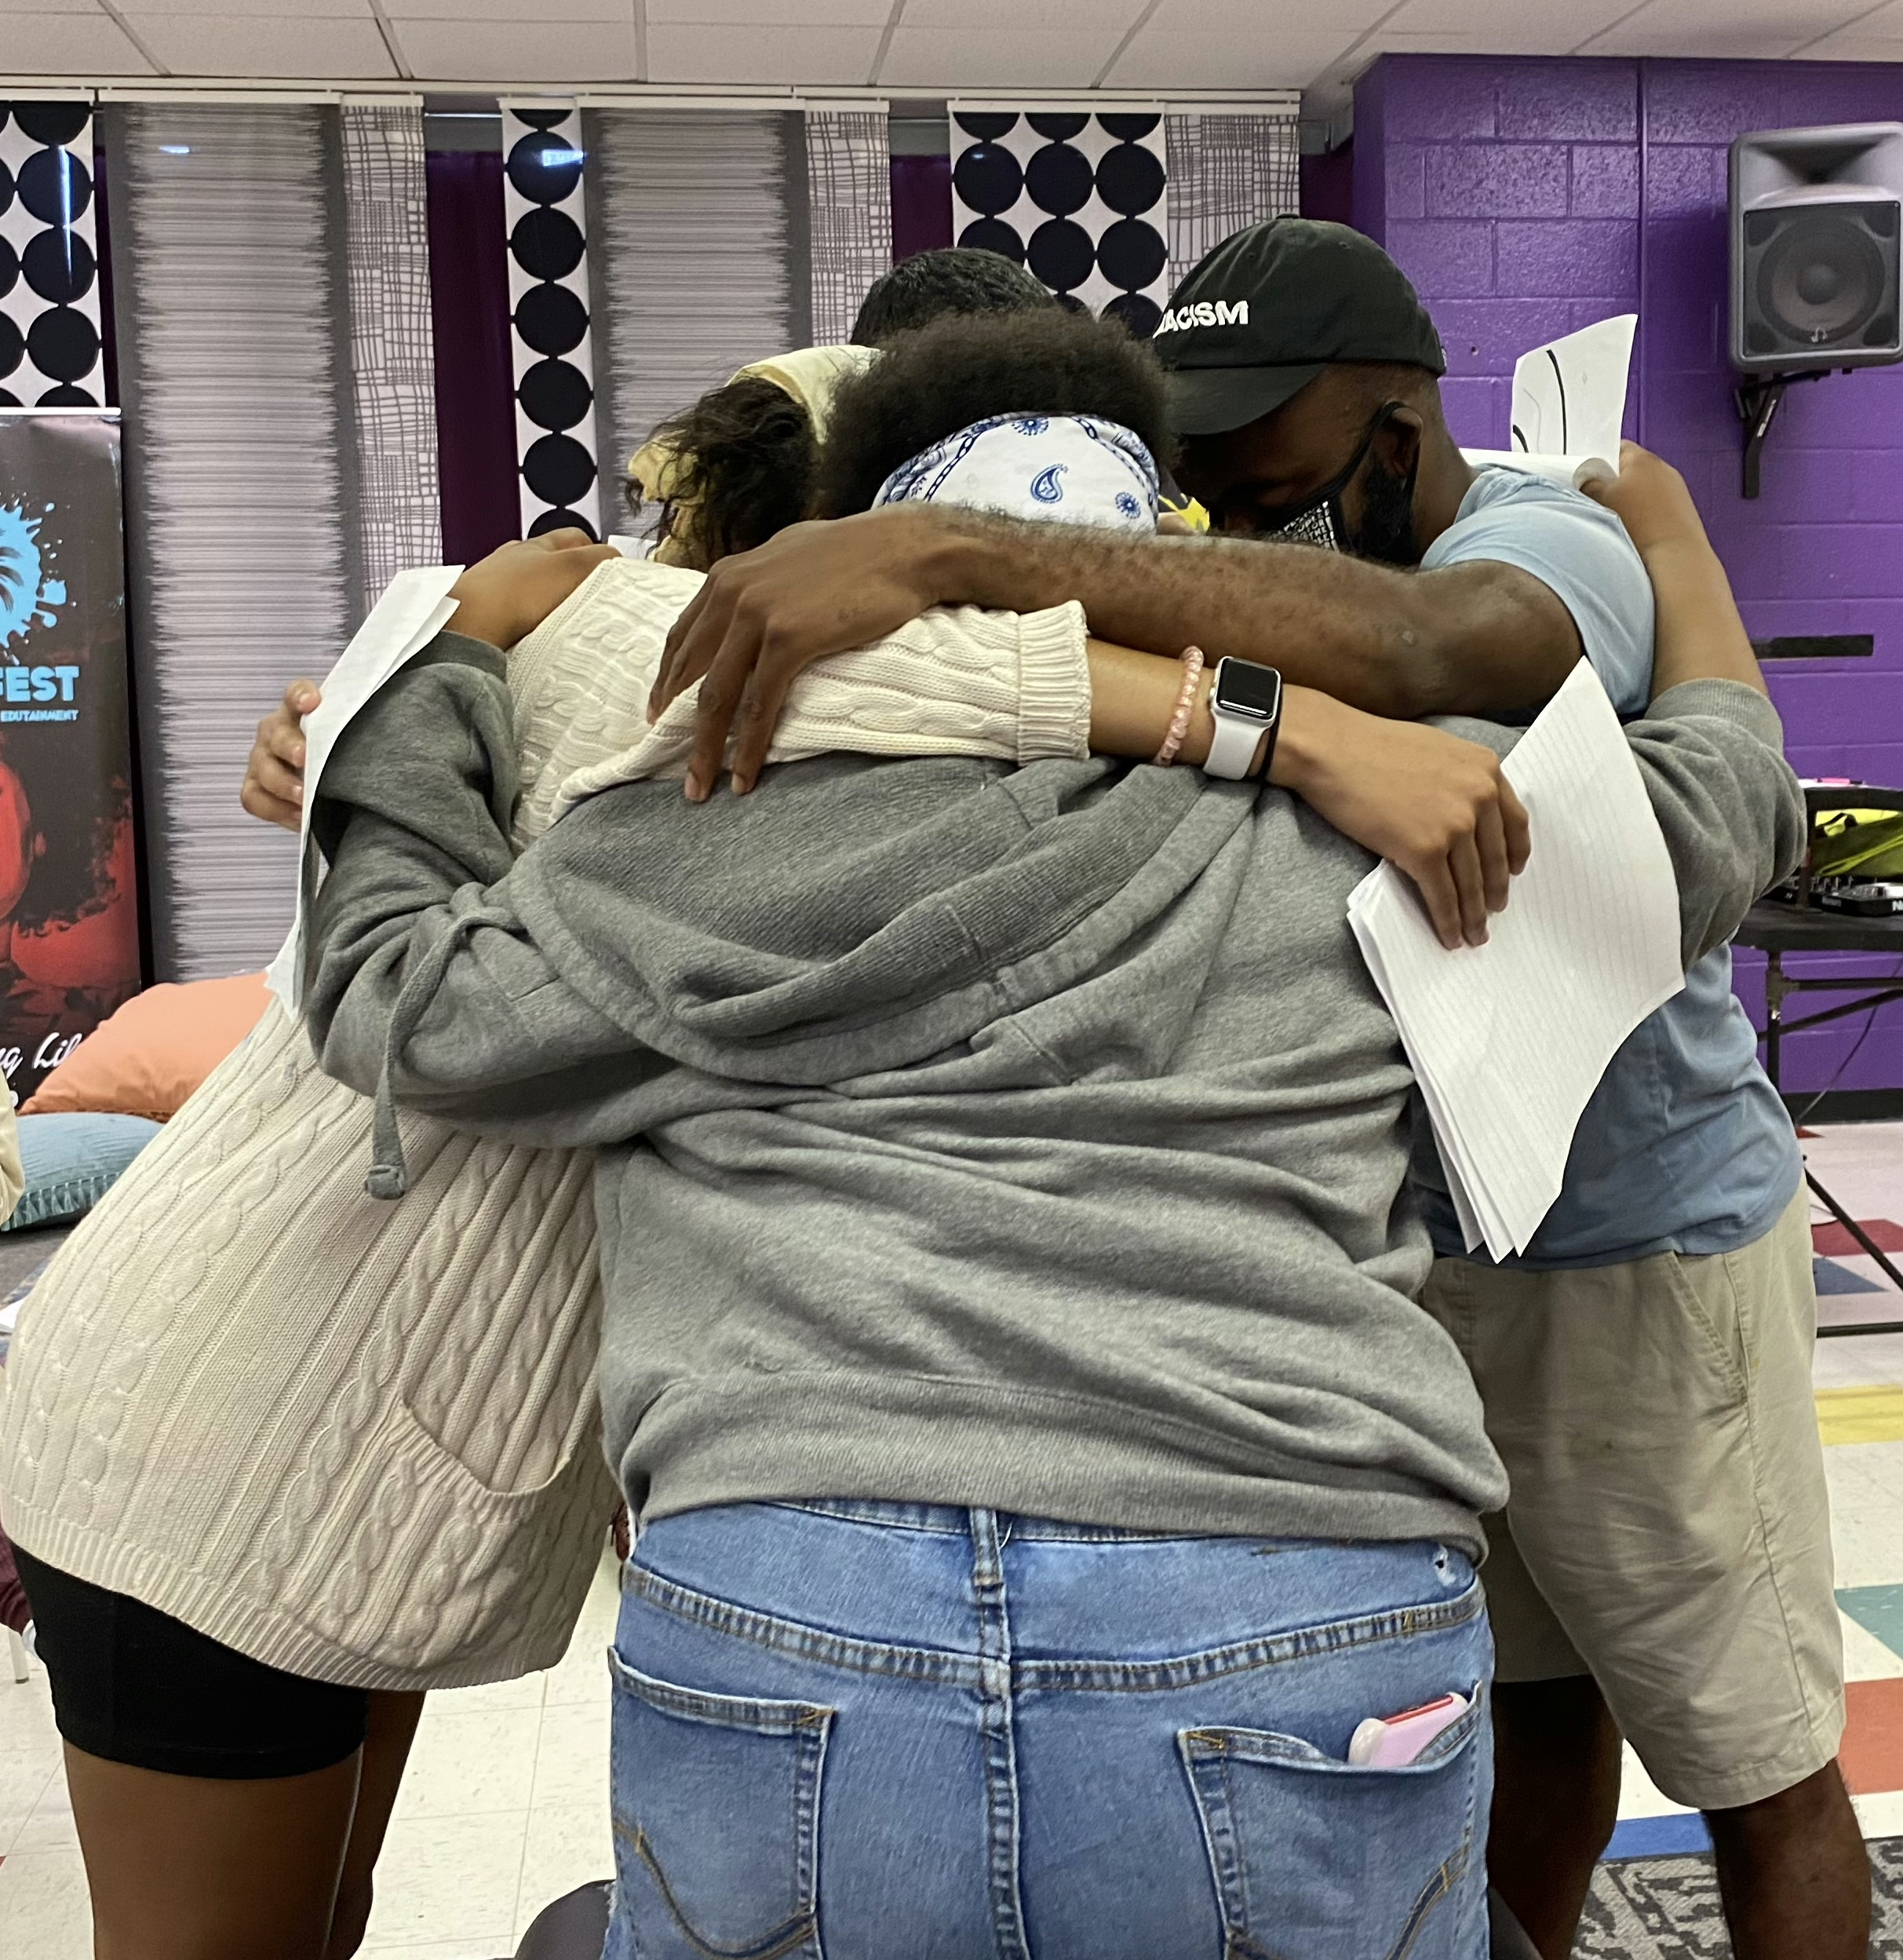
Big Question:
WHAT IS THE INTENT & IMPACT?
Let your curiosities and passions lead you…
When you are thinking about a project/issue, identify:
  community
  potential partner
  guiding questions: What’s leading you? What’s firing you up?

Slide 10
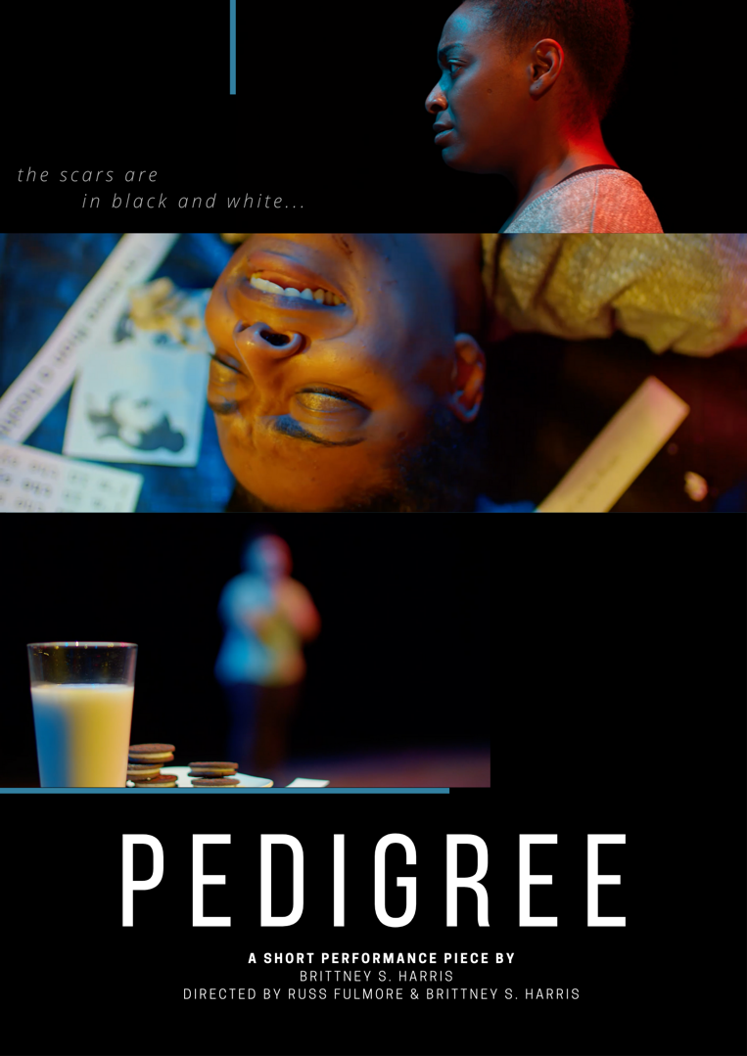
Case Study
Personifying Resistance Through Theatre:
Performing Pedigree
Form of Performance as Activism:
Image Theatre, Cop-In-Head
Theatre of the Oppressed, Augusto Boal
Question explored:
can embodied storytelling be used as a tool for evolving how narratives of resilience are archived, shared, remembered, and incite a dialogue in promoting social reform and change?

Slide 11
Pedigree Impact: Embodying the Resolution
  Response to BLM Movement and George Floyd murder
  The work is about the process of discovery
  The role of the audience-being a ‘spect-actor’ can be therapeutic not therapy
  Interactive dialogue beyond our screens
  Partnering with mental health awareness agencies

Slide 12
Presentation:
PEDIGREE

Slide 13
Personifying Resilience Through Narrative:
Performing Pedigree
Presenter
Brittney S. Harris, Asst. Professor of Theatre
Old Dominion University
b1harris@odu.edu

