Slide 1
Chris Heller, Director, Learning English & Drama Project (LEAD)
Albert Iturregui Elias, Teaching Artist
Raphael Peacock, Teaching Artist
Welcome! Please share in the chat:
your name
your pronouns
where you are zooming in from (including the present-day name and ancestral name. Find this info here: https://native-land.ca/)
Make sure you have something to write with and something to write on during today’s session!
Notes:
https://native-land.ca/

Slide 2
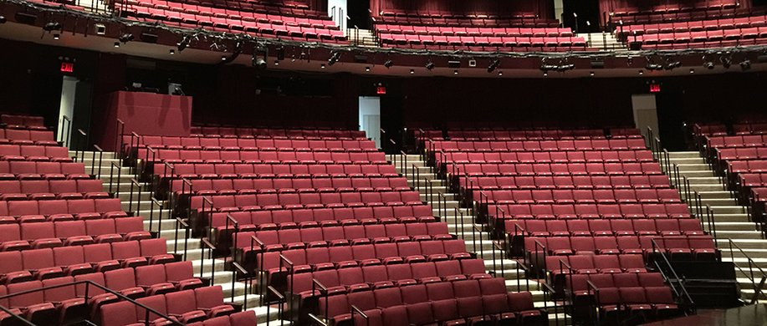
Agenda
Welcome & Introductions
What is LEAD?
Book Intro- March, Book One
John Lewis Timeline
Breakout Groups
Personal Connection

Slide 4
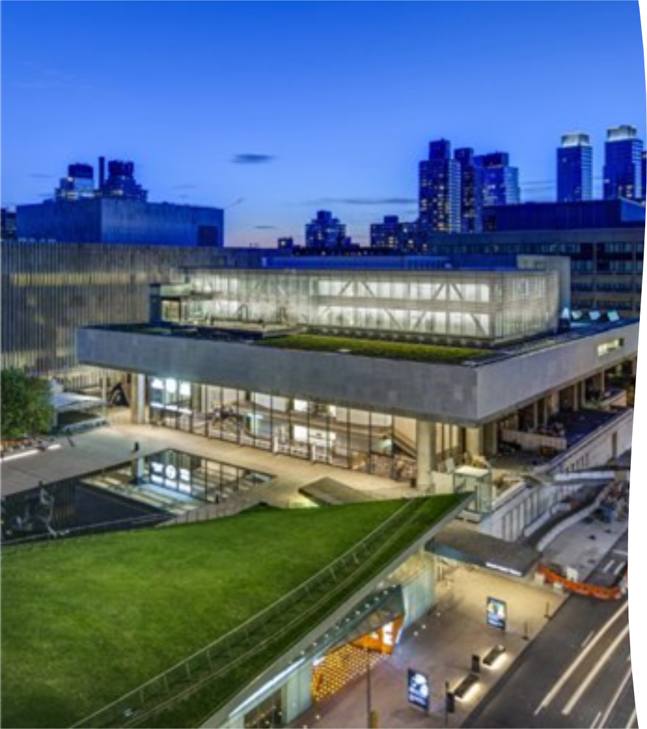
WHAT IS LINCOLN CENTER THEATER?
A large not-for-profit theater company that produces plays and musicals in New York City.
Education programs reach 4,700+ students ages 11-21 in 30+ public schools.

Slide 5
NEW YORK CITY
1,859 schools
813,000 students in grades K-12 (2022-23)
13.9% of students are Multilingual Learners

Slide 6
What is the Learning English & Drama Project (LEAD)?

Slide 7
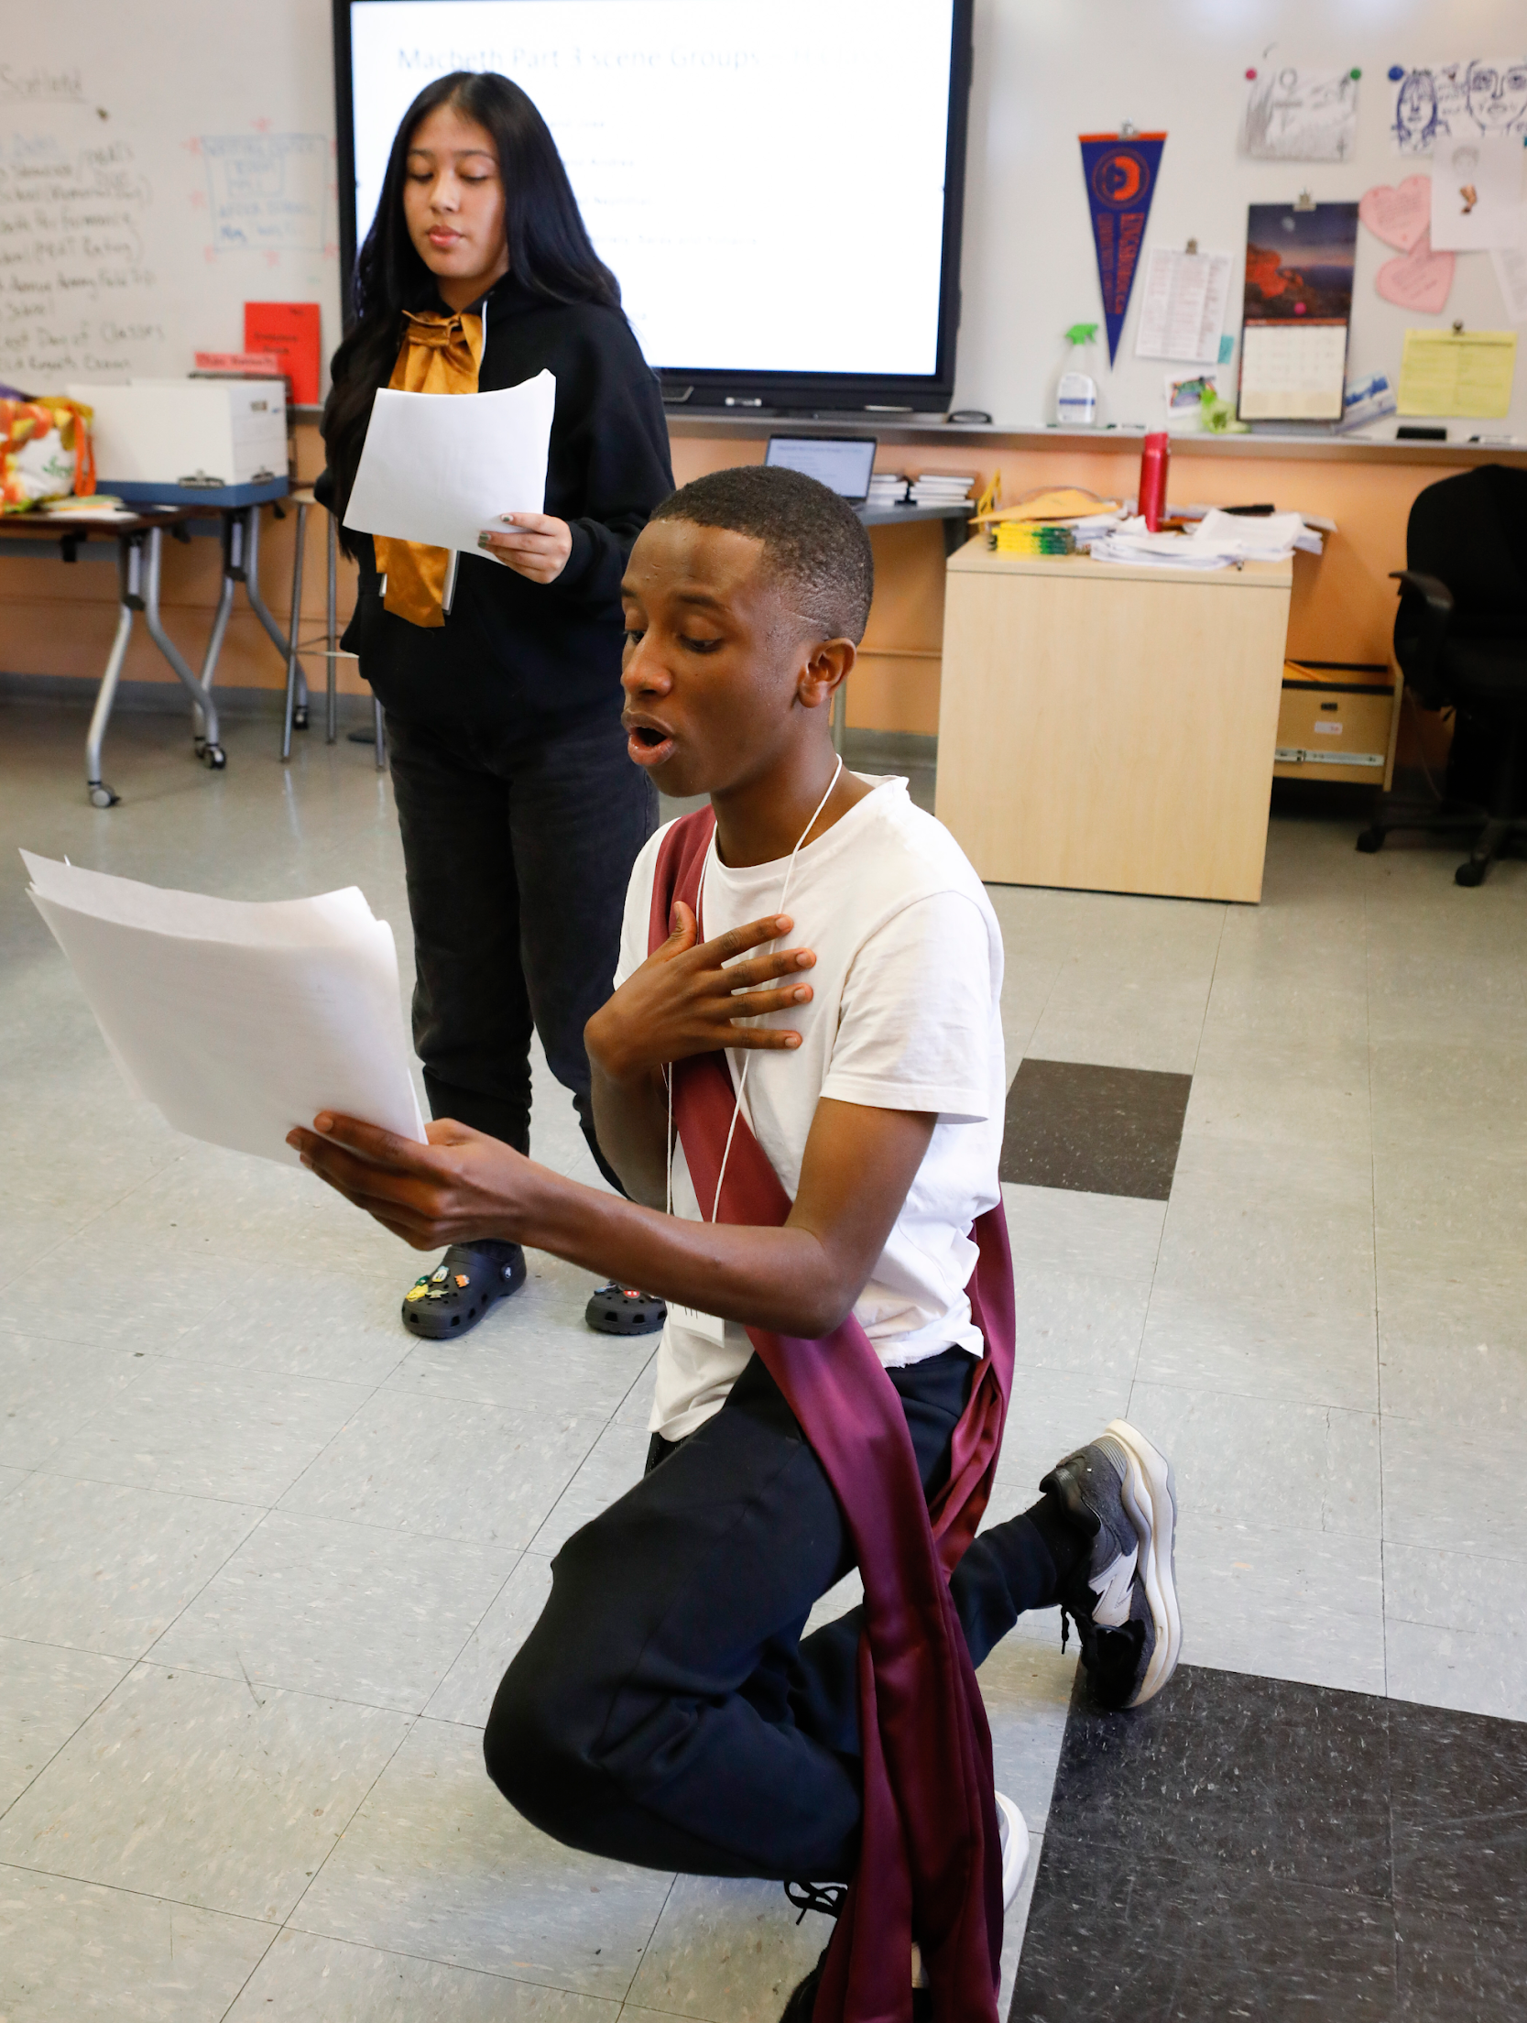
A LEAD residency is...
A partnership between a theater teaching artist and a classroom teacher of Multilingual Learners
10 in-class sessions per semester, culminating in informal sharing
Text-based

Slide 8
RATIONALE
Facilitates comprehension
A “way in” to the text and a basis for more complex understanding
Students can communicate beyond limits of their current language ability
Opportunities for peer-to-peer, social learning
Varied opportunities to structure the purposeful use of language through collaborative student decision-making and creative exploration
Notes:
1. Mixture of high and low focus
2. Memorization – or not
3. Various modes of presentation, e.g. choral speaking, dialogue, narration

Slide 9
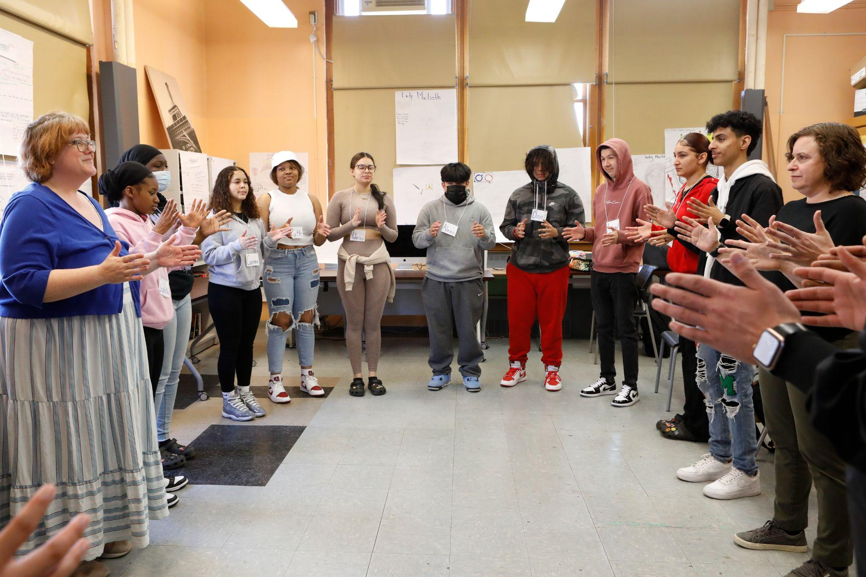
LEAD Strategies
Repetition
Low-focus activities
Choral speaking
Small group work
Multiple modes of communication (text, pictures, translation, and movement/gesture)

Slide 10
March, Book 1

Slide 11
Responding to the timeline
Click on the link
Look at the images. Read the dates and captions.
Reflect
Think of a word, words, or a short phrase that come(s) to mind based on everything you've seen.
Write
Write down your word/phrase.
Notes:
Padlet link: https://padlet.com/dancercmh/john-lewis-timeline-oda1oupwmql276uw

Slide 12
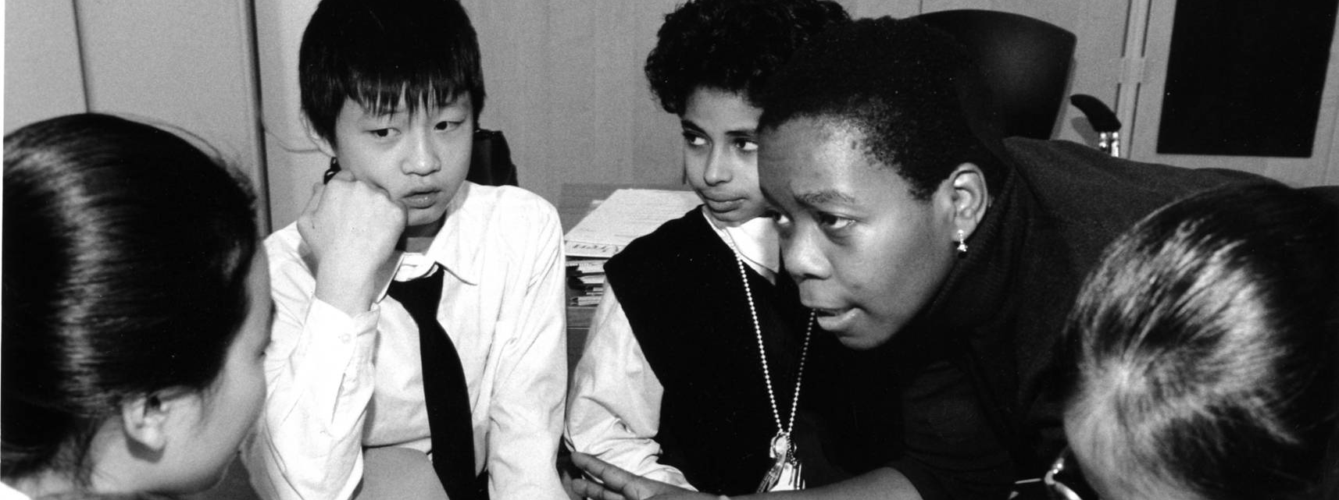
SHARE
1. On the count of 3, we’ll all speak our word or phrase (on mute) all at once.
2. Think about your word and think about a gesture or action that goes with your word –and practice it.
3. (Taking turns) Say your word/phrase with this feeling/gesture and then pass it to someone else on the Zoom.
4. Group echoes the gesture as each person shares.

Slide 13
Breakout Rooms
In a moment, you will be put in a breakout room in groups of 3 or 4.
We will assign* each group a photo from the timeline to explore further.
*When we do this session in person, we let participants form groups based on what photo speaks to them.
Notes:
https://drive.google.com/file/d/1Oub80btEckPthJu7oraGKFghtcQJ3kYC/view?usp=sharing

Slide 14
Example:

Slide 15
Responding to the quote
With your group:
Each person reads the quote aloud – one at a time.
Think: How does this line make you feel?
Write this feeling down for yourself.
Each person creates a gesture that expresses the feeling they wrote down.
Notes:
https://drive.google.com/file/d/1Oub80btEckPthJu7oraGKFghtcQJ3kYC/view?usp=sharing
To post in chat: With your group:
Read the line together - chorally
Each person reads the quote aloud – one at a time
Think: How does this line make you feel?
Write this feeling down for yourself on the back of your quote
Each person creates a gesture that expresses the feeling they wrote down

Slide 16
Text + Gesture
Decide how to perform your quote:
• The whole quote must be spoken.
• Everyone must speak at some point.
• Make creative choices: echoing,
choral speaking, splitting up the
line.
Combine speaking your quote with doing your gestures.
Rehearse and get ready to share.
Notes:
To post in chat: Decide how to perform your quote:
• The whole quote must be spoken
• Everyone must speak at some point
• Make creative choices: echoing,
choral speaking, splitting up the
line
Combine speaking your quote with doing your gestures.
Rehearse and get ready to share.

Slide 17
Rehearsal
Practicing our lines and gestures for the performance

Slide 18
CHAT WATERFALL
Complete the sentence in the chat, but don’t hit ENTER yet!
"We shall overcome ______ some day."

Slide 19
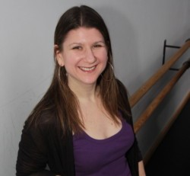
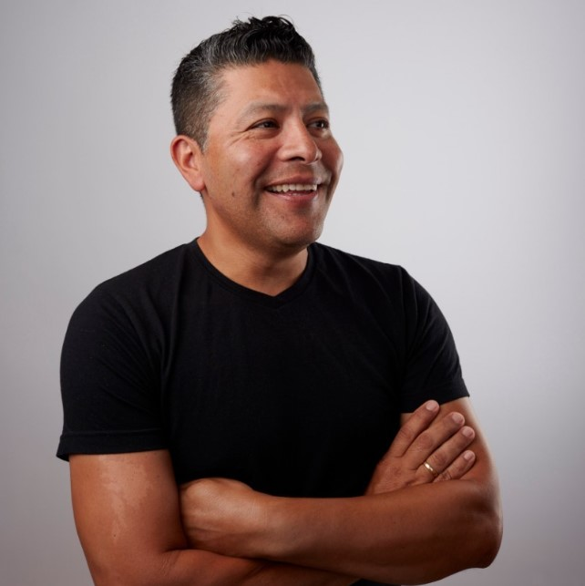
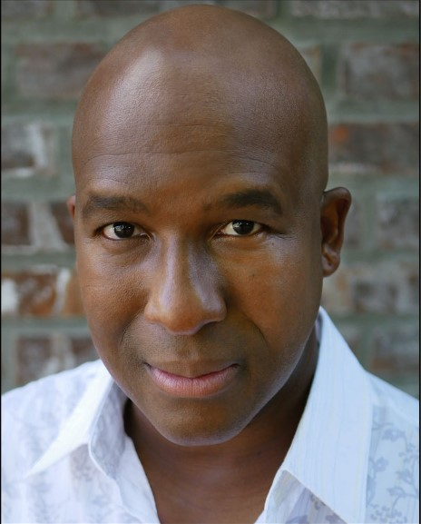
Stay in touch!
Chris Heller
chris.heller@lct.org
Albert Iturregui Elias
justalbertelias@gmail.com
Raphael Peacock
raphpea2@gmail.com
Lincoln Center Theater
www.lct.org

